Slide 1


Group 6
Kramer Johnson
Anthony Pinza
Jun Liao
Xinyu Qiu

Slide 2


OUR MISSION
integrates all potential travel resources, providing a one-stop service for users to start a travel plan conveniently
Globetrotter features high-quality recommendations on trips for users based on their customized needs
Globetrotter helps user secure affordable expenses, gather all their preferences, and develop a distinct traveling experience without breaking the bank.
Notes:
https://www.shutterstock.com/zh/image-illustration/3d-renderer-image-globe-ball-zipper-412105105

Slide 3
PROBLEM STATEMENT
Anyone who has ever planned an overseas excursion knows the challenges that face them when deciding:
Where to go?
What to do?
How to budget?
How to get there?
All of these decisions are important when choosing a place to go, but how do will you know where the right place to go is? A misstep in any of these decision-making processes has the potential to ruin what could’ve been a great vacation.

Slide 4
OUR SOLUTION
Our users will be able to rate places they’ve visited, specific sightseeing options in each spot, what their favorite restaurants were, among other options that will create a huge database that all of our members will be able to access in order for them to get the exact trip they are hoping for.
For each desired destination, we will provide an average cost that our other users have spent on a trip to that location, as well as how to get there. This will provide a clear outline of what you can expect for your upcoming adventure or give you an idea for something that you want to plan later on.
Our all-encompassing database will be filled with every answer you need to your traveling questions. However, it will also be extremely flexible as well. If you want a more hands-on planning experience you will be able to. If you are just looking for answers, those will be provided. Our hope is to give you everything you want when preparing for a vacation, so that while traveling, the only thing you are worried about is where to go next.

Slide 5
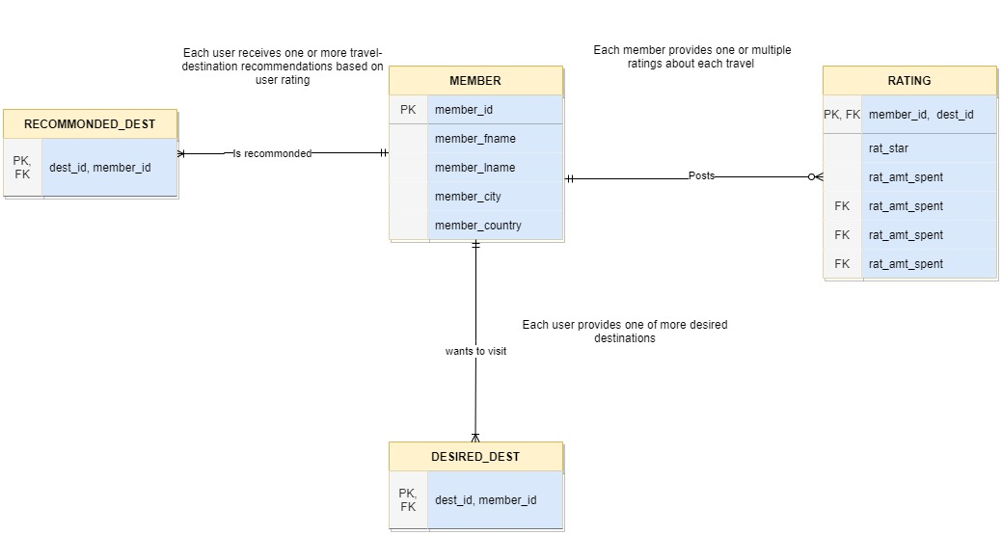
User Interface
Notes:
https://drive.google.com/file/d/1VE-JIhGW3YIkaWFT8r1mWJ1OqnCnUem7/view?usp=sharing

Slide 6
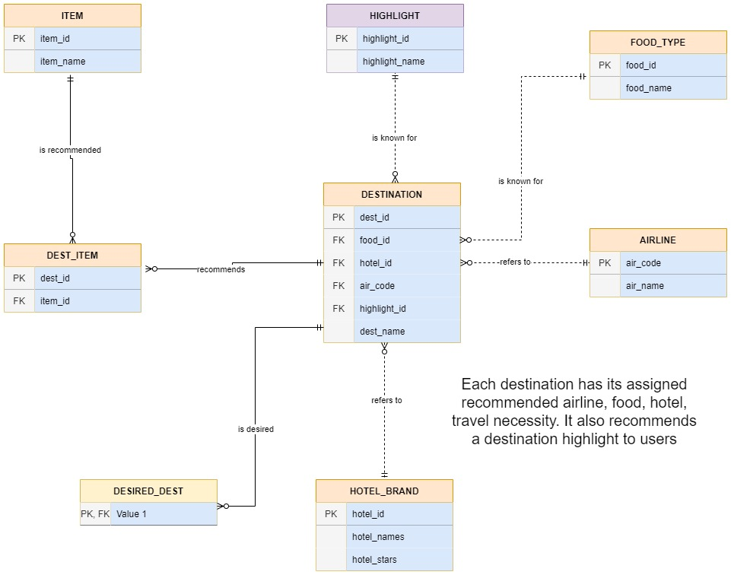
Destination Database
Notes:
https://drive.google.com/file/d/1gbPSBLxl9GcrD8CxRoBy4jQaHmCEbKSp/view?usp=sharing

Slide 7
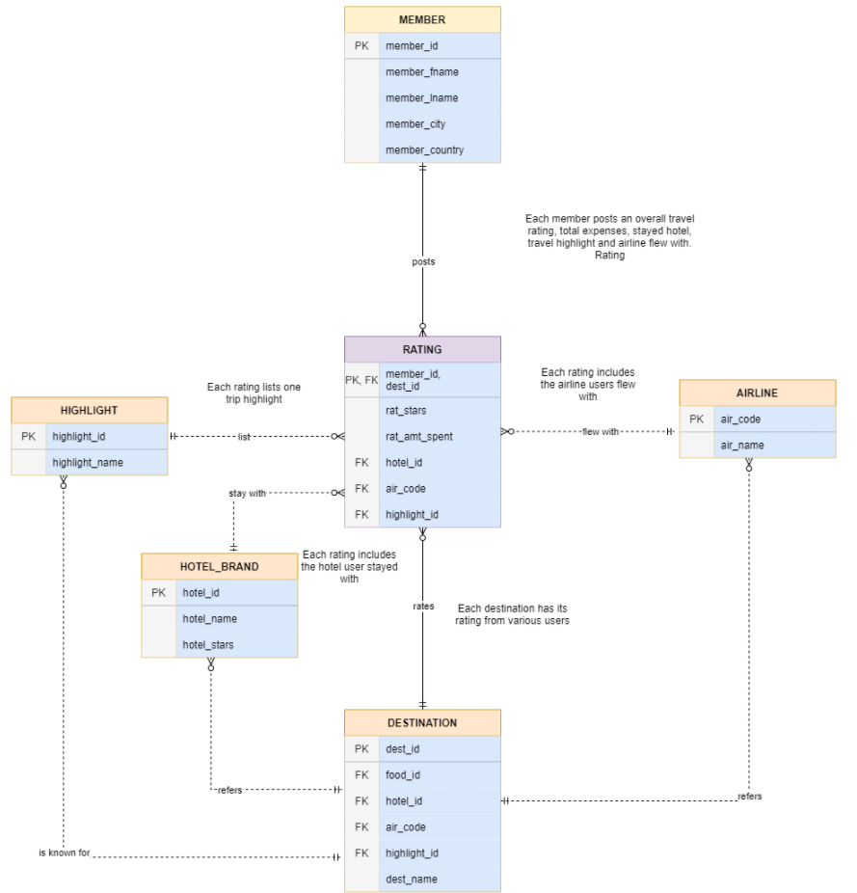
User Rating
Notes:
https://drive.google.com/file/d/1_utqhZQvoZqI4LovThCWv1BEv_VSs5oj/view?usp=sharing

Slide 8
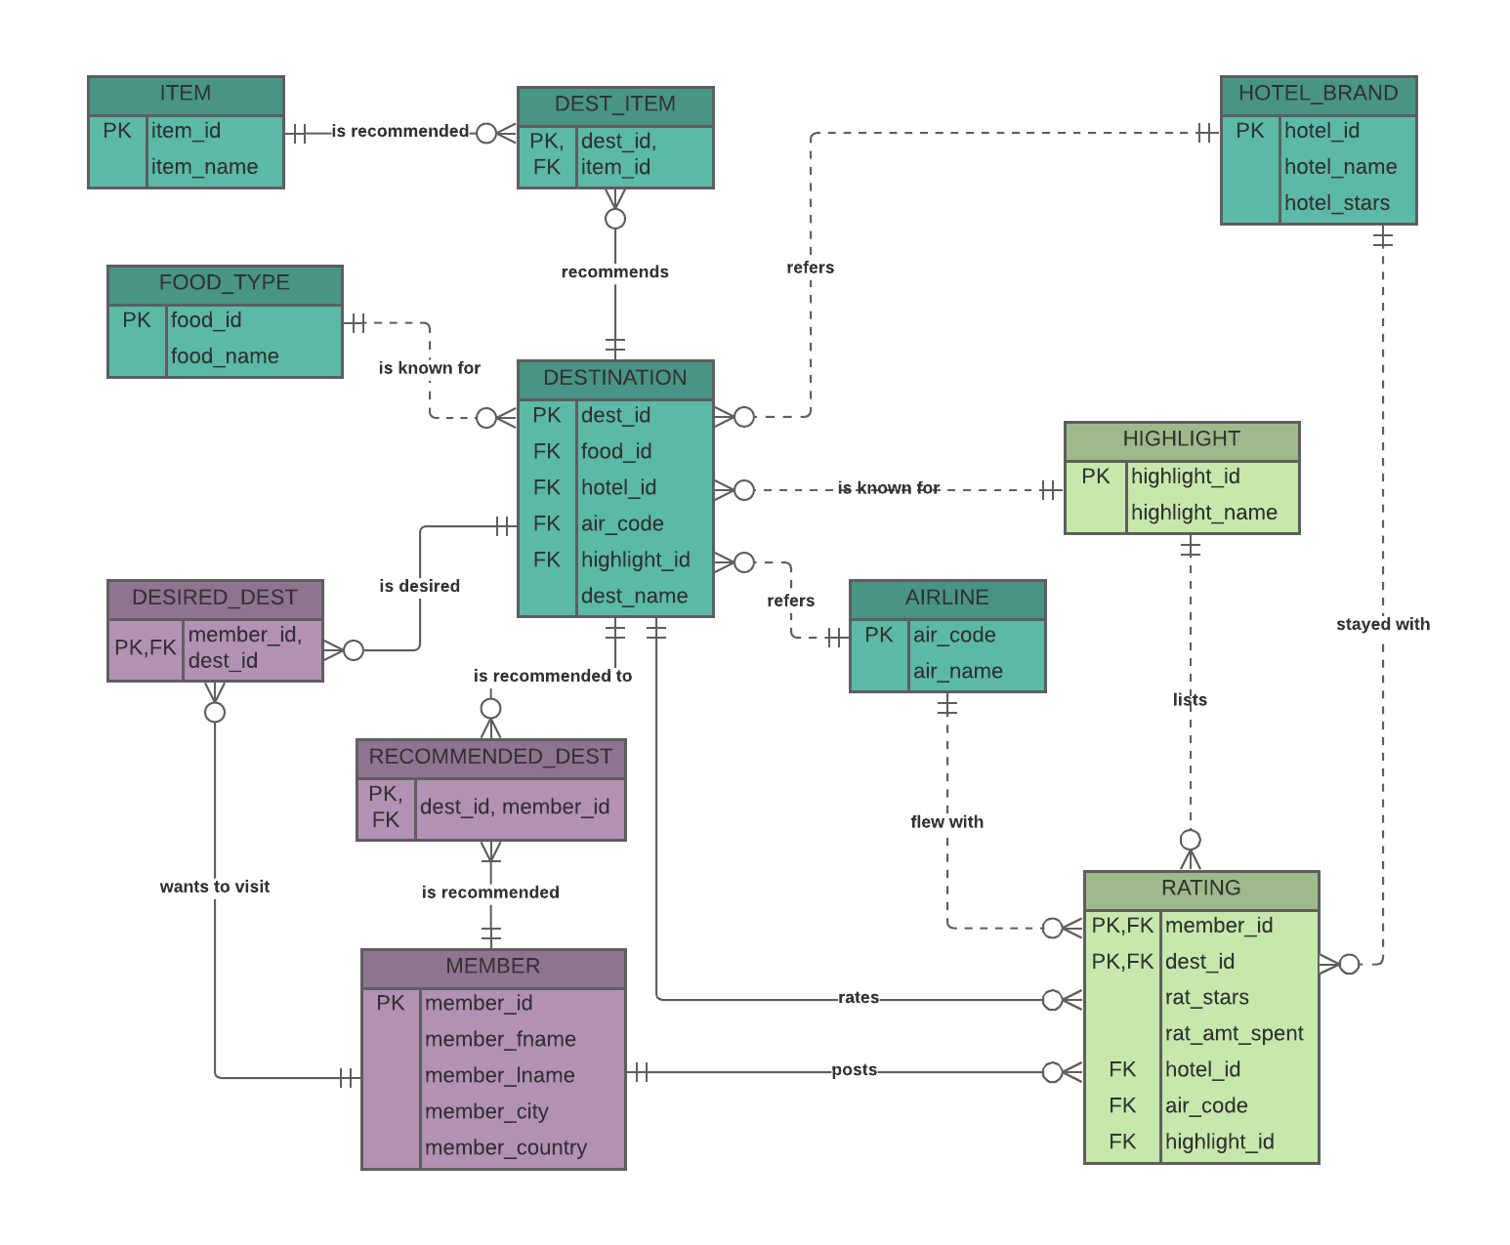
The Conceptual Model

Slide 9
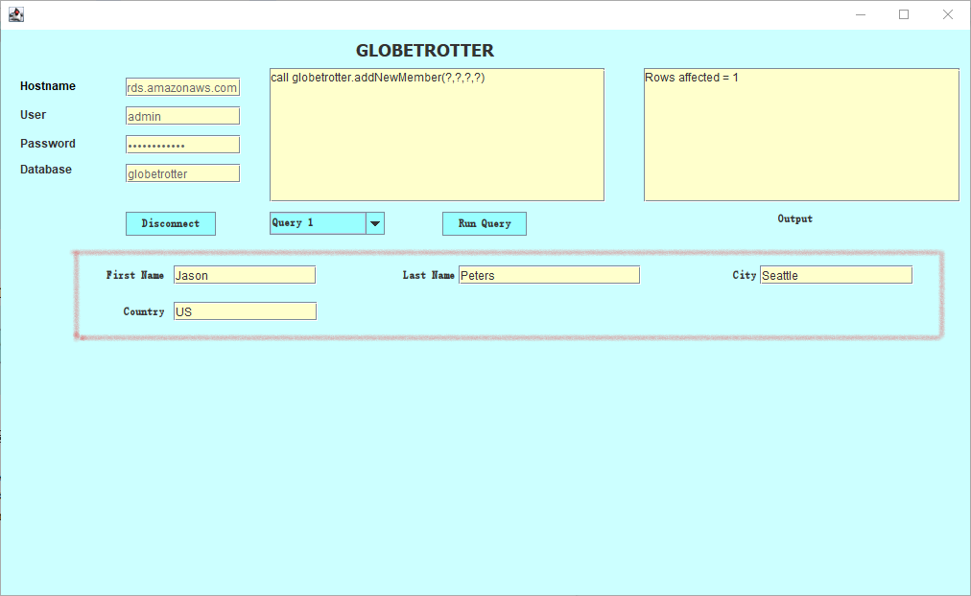
Add A New User

Slide 10
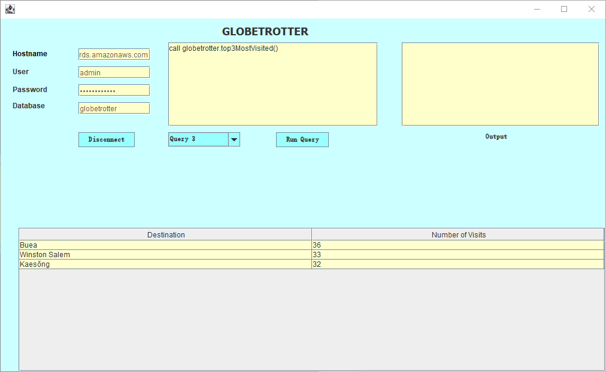
Top 3 Most Visited Destination

Slide 11
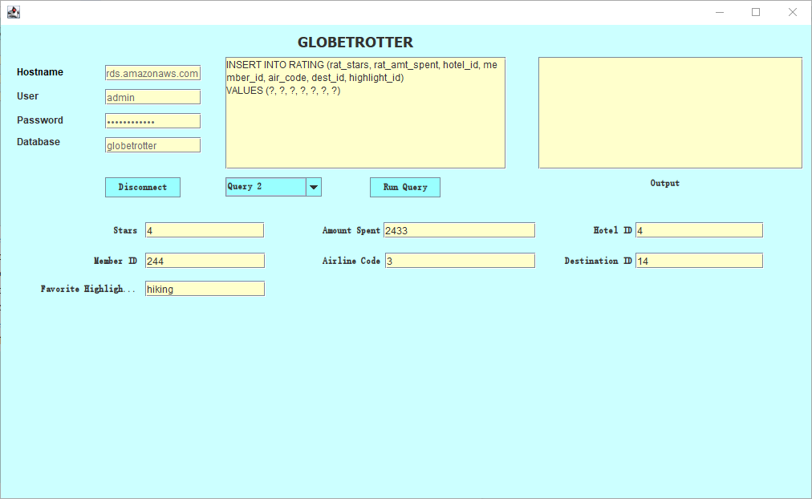
Add New Rating

Slide 12
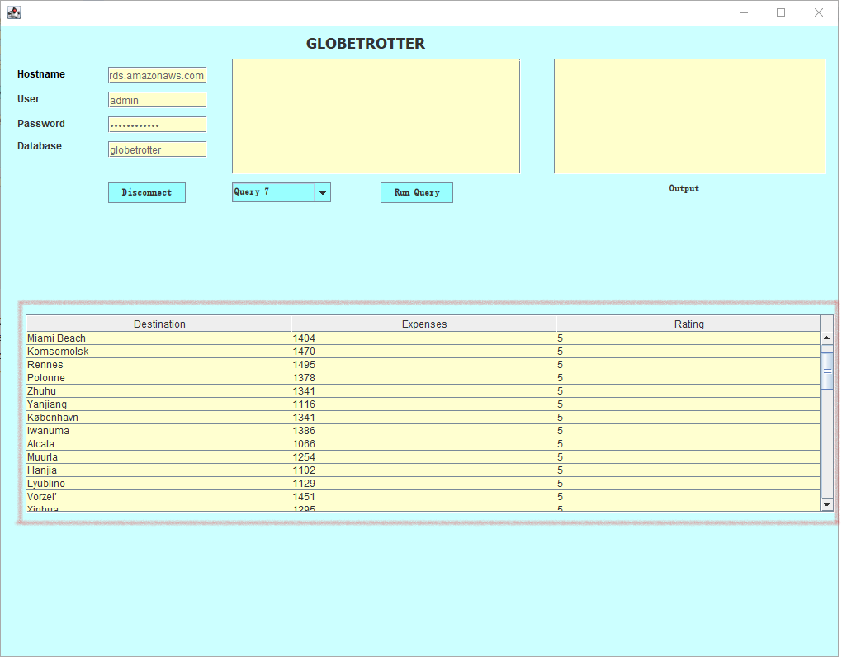
Bang For Your Buck

Slide 13
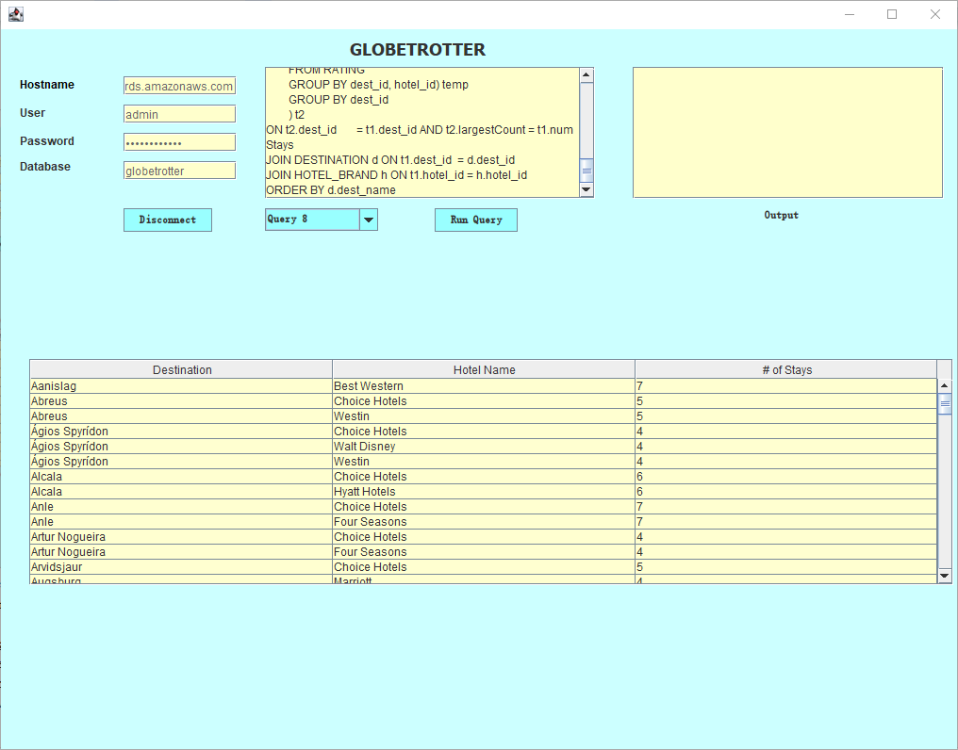
Most Popular Hotel In Each Destination

